Slide 1



Multilingual Company Profile Management System

Slide 2




OVERVIEW
A comprehensive platform designed to break down language barriers and streamline global data operations with intuitive, real-time synchronization.
Global Language Support
Dynamic Language Addition
Native support for English, French, and Arabic ensures accessibility across diverse international markets and user bases.
Add new languages without system downtime, enabling rapid expansion into emerging markets.
Real-Time CRUD Operations
Consistency Across Platforms
Create, read, update, and delete company data with instant synchronization to backend systems and databases.
Maintain data integrity and uniform presentation across all language versions and user touchpoints.
Key Capabilities
Business Impact
Centralized company data management
Reduced operational overhead
Multi-language content versioning
Faster global market entry
User-friendly admin interface
Enhanced data accuracy
Automated backend synchronization
Improved user experience worldwide

Slide 3






Full-Stack Development Architecture
Frontend Layer
Backend Layer
Data Layer
React.js powers the user interface with component-based architecture
Node.js with Express handles server-side logic and API endpoints
PostgreSQL provides robust relational database management
Vite enables lightning-fast development with hot module replacement
Multer processes file uploads efficiently
pg package connects Node.js seamlessly to PostgreSQL
CORS enables secure cross-origin requests
React Router DOM manages seamless navigation and routing
dotenv secures environment configurations
Development Tools
Visual Studio Code: Primary IDE for full-stack development
Postman: Comprehensive API testing and validation
Nodemon: Automatic server restart during development
Custom CSS: Tailored styling for unique UI experiences

Slide 4

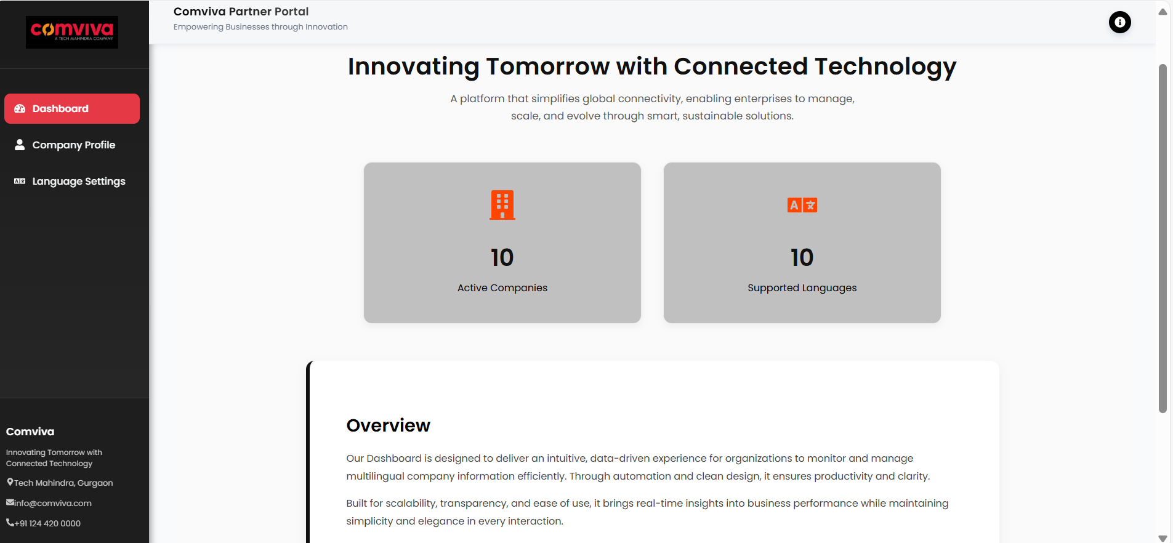
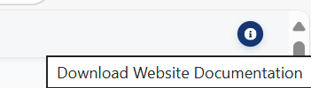
Dashboard Overview
Centralized hub for instant system visibility and key metrics
Language Inventory
Company Database
Real-time count of all active languages configured in the system
Total registered organizations currently stored and accessible

Slide 5
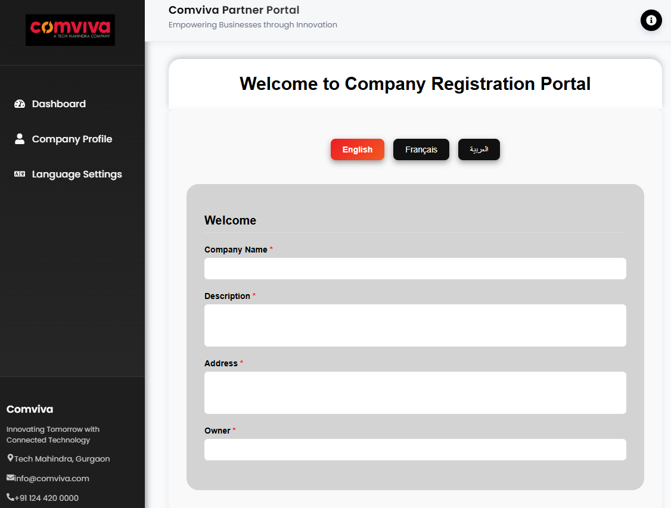
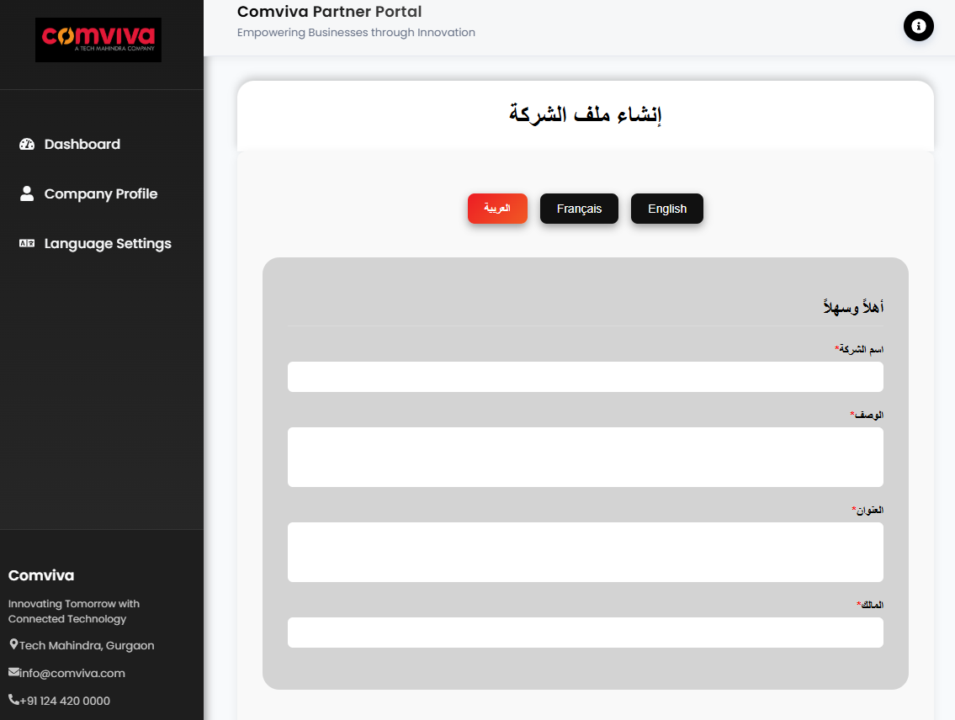
Company Registration Form
Core Information
Company ID, Name, Owner details, Address and business description
English
Arabic

Slide 6
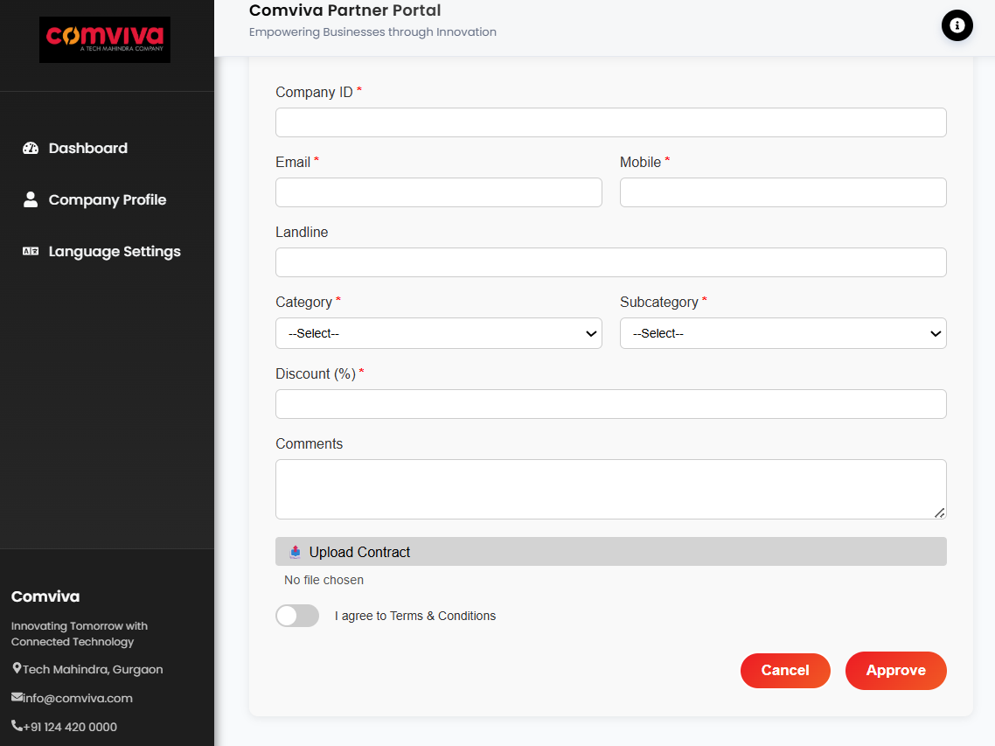
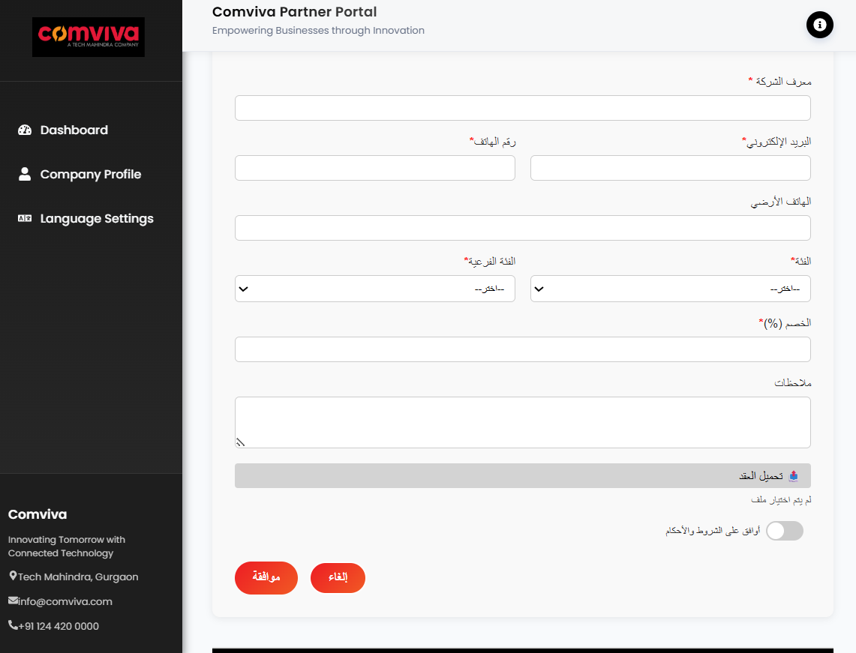
Company Registration Form
- Contact & Classification -
- Business Details -
Discount specifications, Additional comments field
Email and mobile number, Category, subcategory selection
English
Arabic

Slide 7
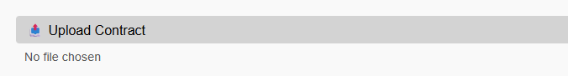








File Upload with Multer Middleware
Why Multer?
Express cannot handle multipart/form-data by default. Multer provides essential capabilities for file processing in Node.js applications.
Multipart Parsing
File Validation
Processes multipart/form-data streams efficiently for file and text data
Validates file size limits and restricts types to PNG, JPG, PDF, JPEG
Secure Storage
Error Management
Saves files to designated /uploads directory with unique naming
Handles upload failures gracefully with detailed error messages

Slide 8






End-to-End Data Flow: Form to Database
Backend Processing
Node.js/Express receives data. Multer handles file upload, storing contract in server folder and saving file path.
Frontend Submission
User fills form with company details and uploads contract. Data sent via Fetch API to backend.
Database Storage
Form data (company name, owner, address, description, language) inserted into PostgreSQL database with file paths.

Slide 9
Testing & Verification
API endpoints tested using Postman
JSON responses confirm successful data transmission
PostgreSQL database verified for correct data storage
POSTMAN IMAGES
POST & GET

Slide 10
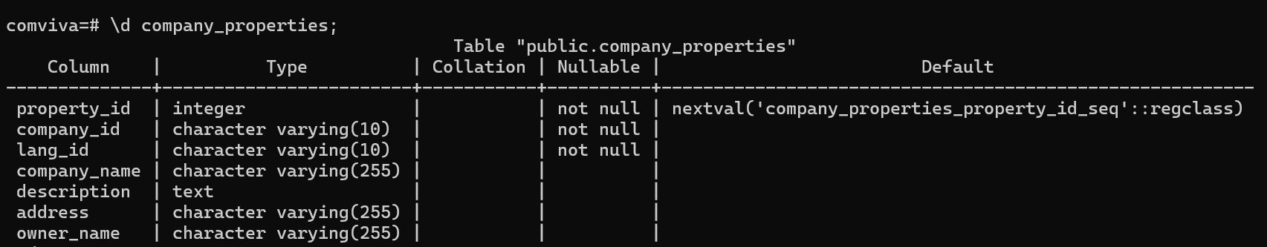
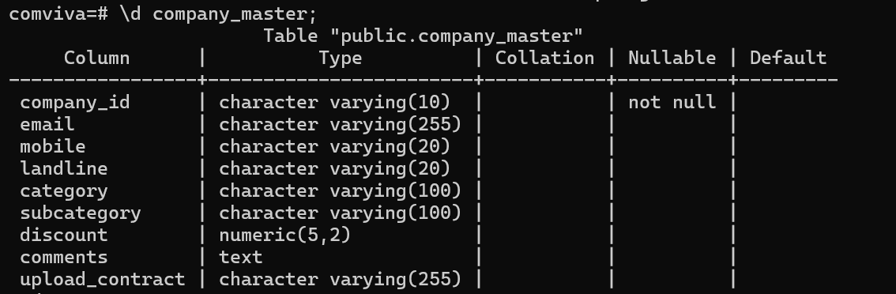
PostgreSQL Database Integration
Schema Design
company_id + lang_id creates composite primary key in company properties table
company_id serves as primary key in company master table
Foreign key relationships ensure referential integrity
Multilingual support through properties table architecture

Slide 11
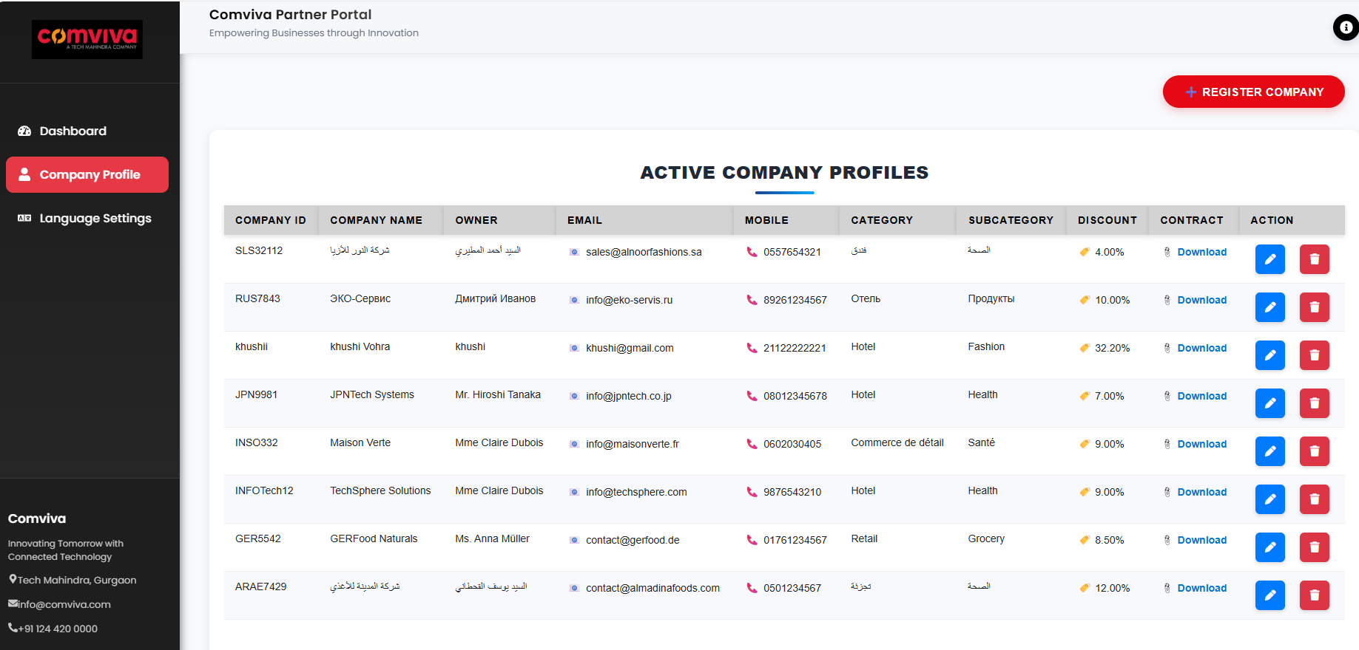
Company Profile Page
Real-time display of active company profiles from PostgreSQL database via React.js frontend
01
02
03
Data Storage
Database Retrieval
Frontend Display
Form submission stores company data in backend and database
PostgreSQL fetches entries through backend APIs
React.js renders profiles in real-time
Contract Management
Download link for uploaded documents
Files stored via Multer on server
Direct access using saved file paths

Slide 12
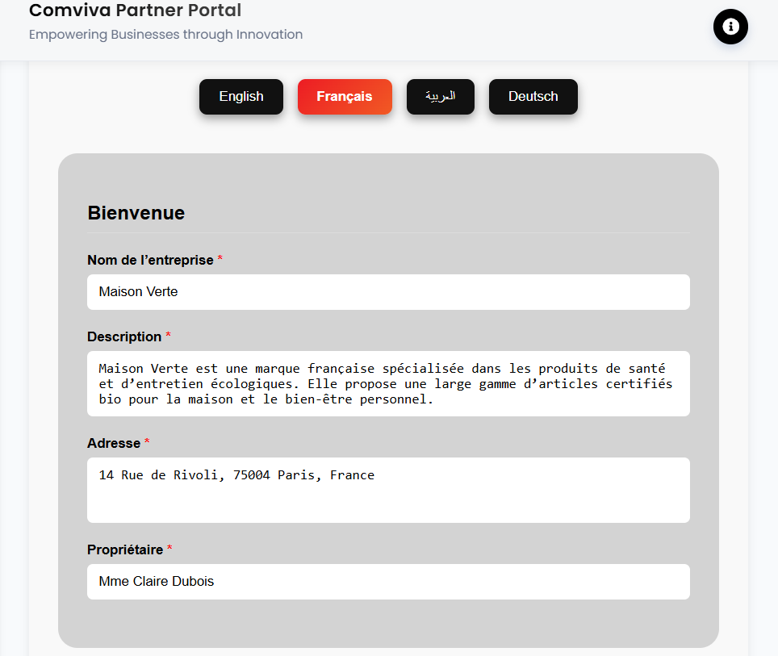

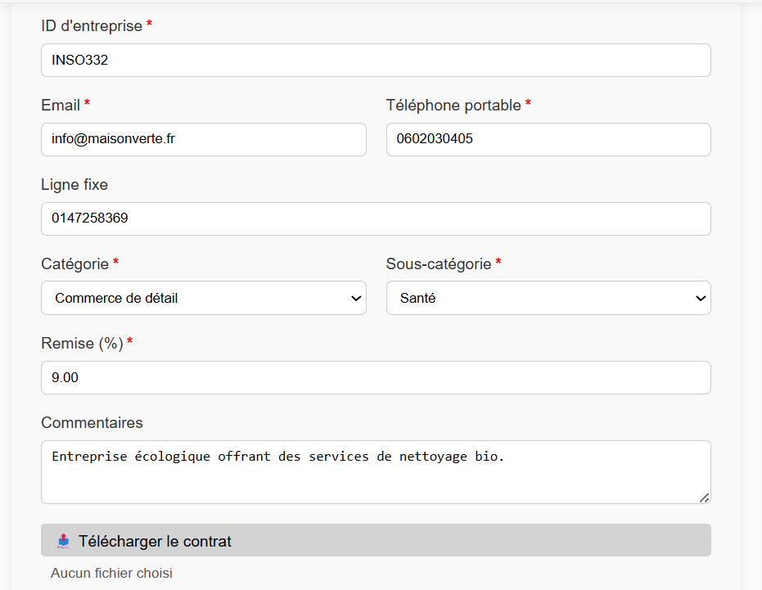
Profile Management Interface
Edit Functionality
Pencil icon triggers update mode, redirecting users to the profile creation form with existing data pre-populated for seamless editing.
Delete Operations
Delete icon removes profiles from both the frontend display and database, ensuring complete data cleanup and integrity.

Slide 13
Update Process Architecture
01
02
03
Edit Trigger
Data Retrieval
Form Population
User clicks pencil icon on existing profile record
Frontend fetches existing data from database via API
Profile creation form loads with pre-populated data in user's language
04
05
Selective Updates
Database Sync
Only modified fields are updated, preserving unchanged data integrity
Backend processes changes and updates database records accordingly

Slide 14
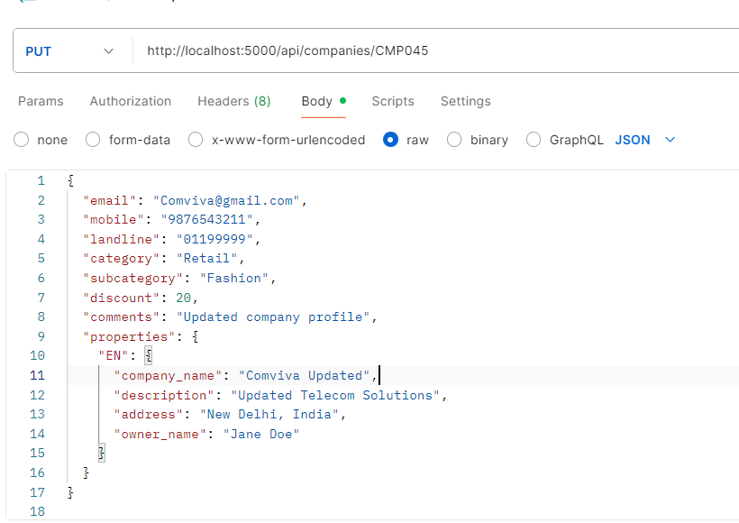
API Integration & Testing
Backend API Testing
Comprehensive API testing using Postman ensures reliable data operations:
Update existing records
Delete profile data

Slide 15
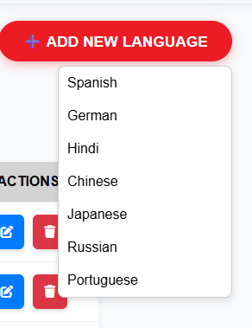
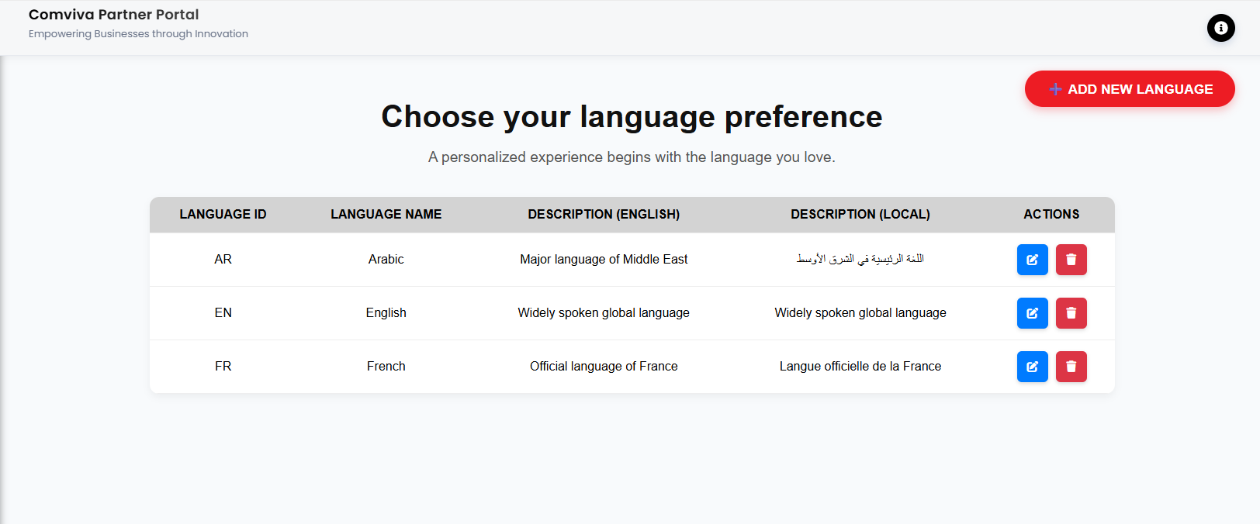
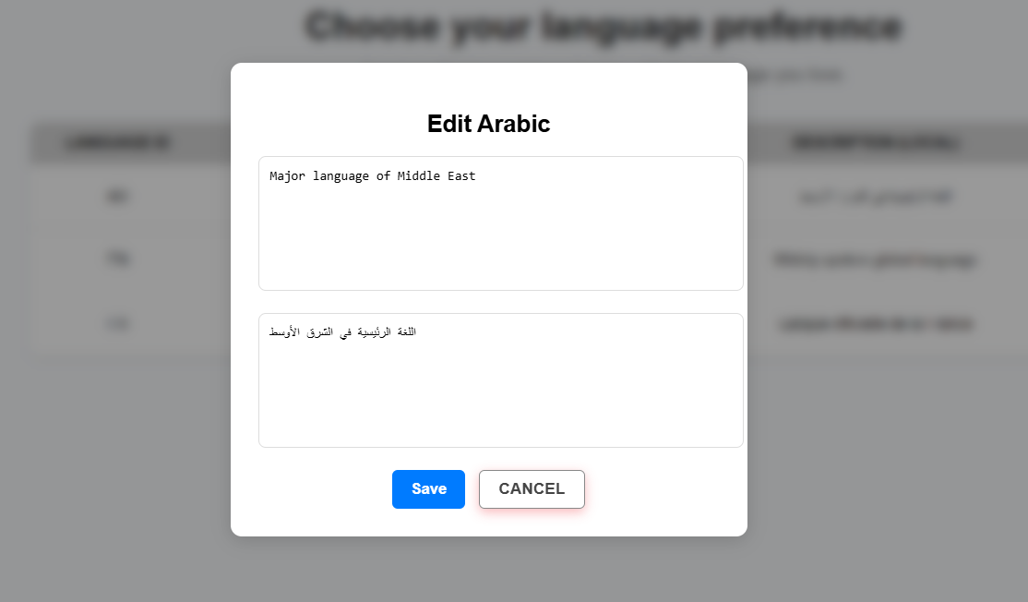
Language Settings & Configuration
Dedicated language settings panel featuring
Two default languages pre-configured
Expandable dropdown for additional languages

Slide 16
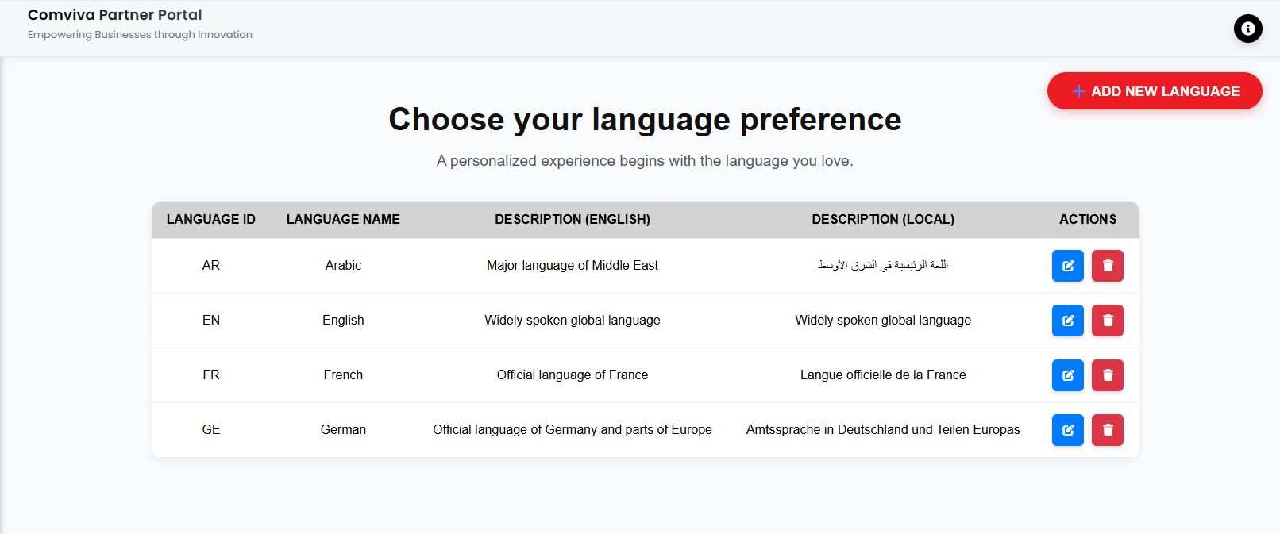
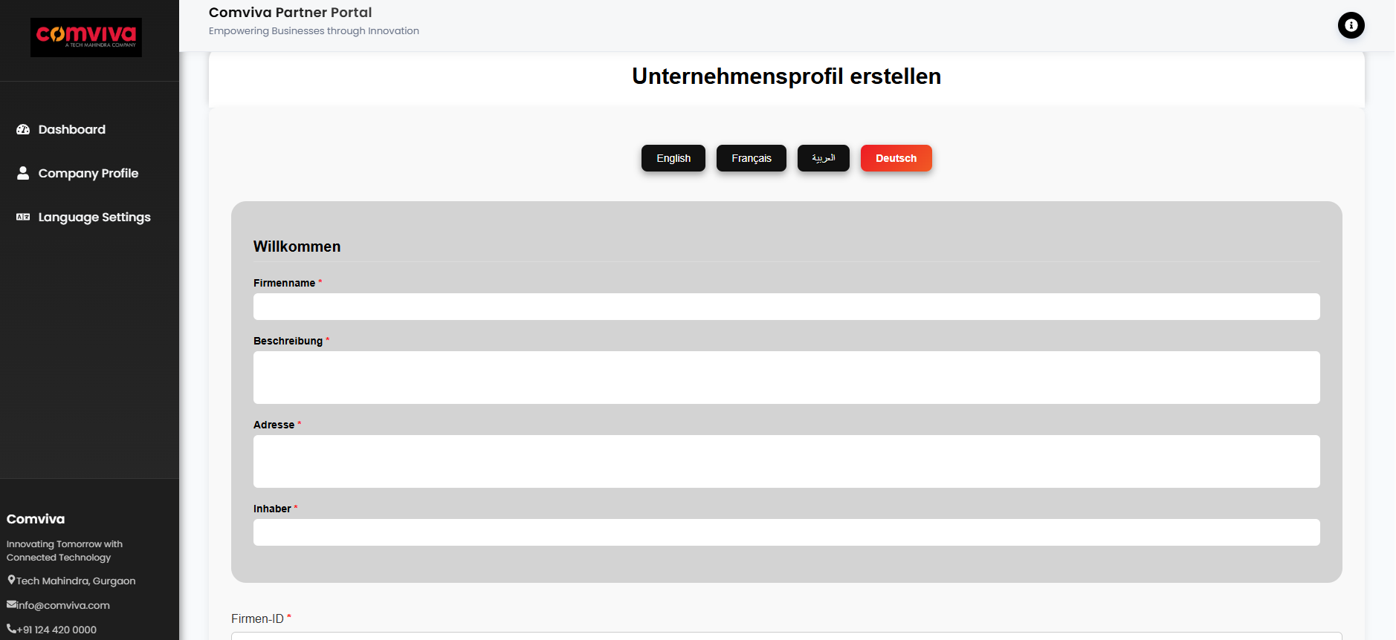
Language Settings & Configuration
Dynamic Language Addition
Users can select additional languages from the dropdown menu, which automatically:
Adds languages to the active table
Updates the profile creation interface
Enables multilingual data input

Slide 17
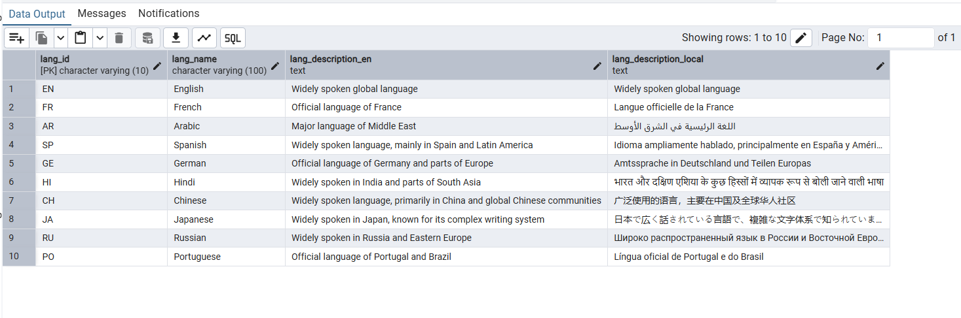
Language Table Database

Slide 18
THANK YOU!

